Slide 1
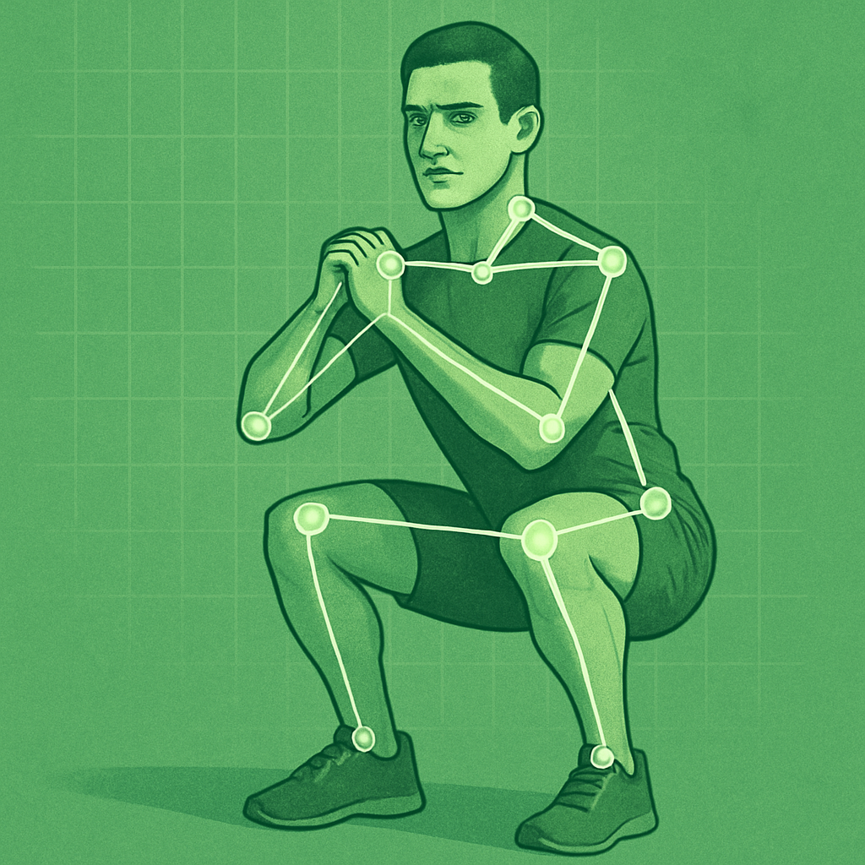
Squat Analysis
Capstone
Project
By
Cullen Capili, PT, DPT

Slide 2
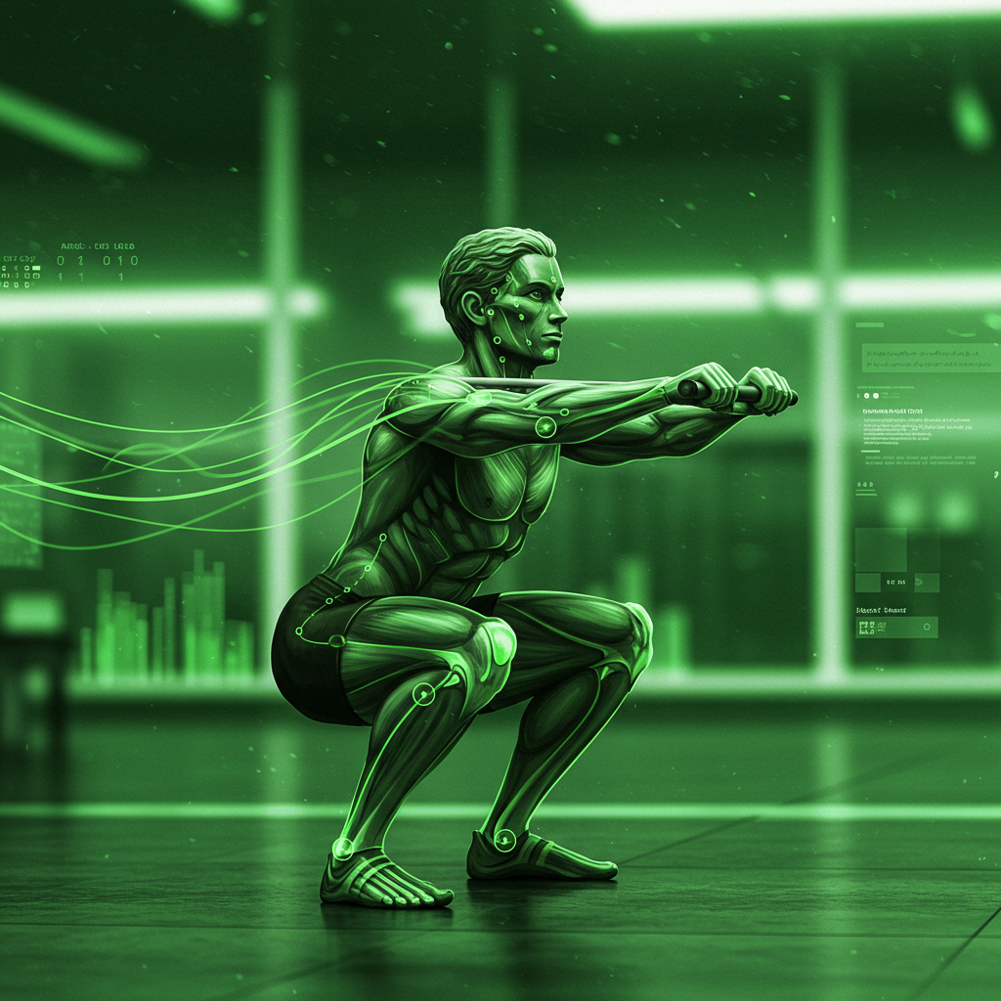
Objective:
Develop an automated real-time squat analysis system that provides objective feedback on squat form.
Applications:
Tool for fitness enthusiasts, personal trainers, and rehab professionals

Slide 3
Disclaimer
This is a proof-of-concept model for possible rehabilitation & fitness application.
Images that were used in training were NOT all my own by me.
This is NOT for commercial use.
NOT meant as a replacement of skilled assessment.

Slide 4
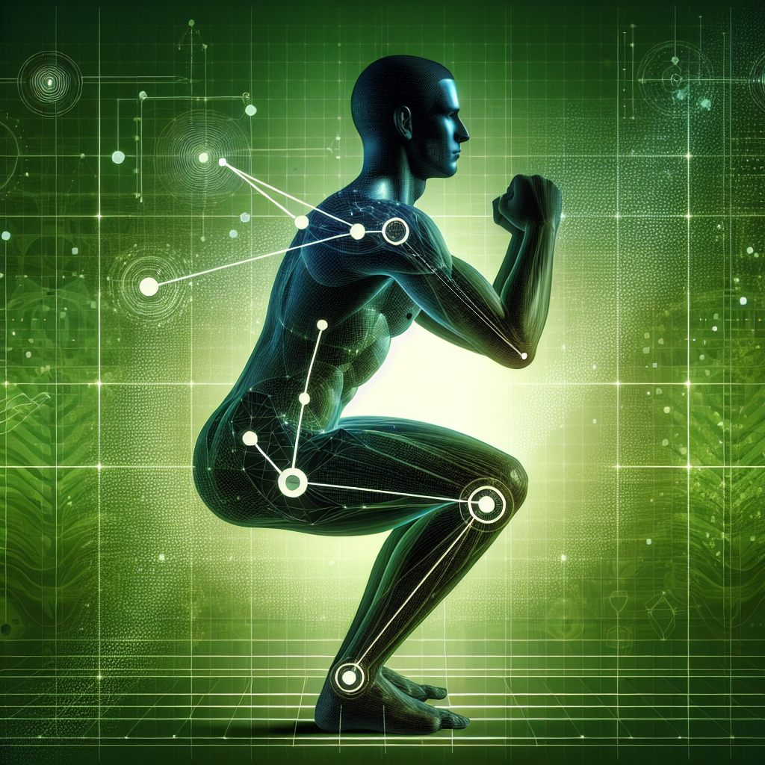
What do I need Model to do?
Detect a person in an image and predict keypoint skeleton accurately and reliably
Classify image according to labels:
Point-of-View (POV), Equipment use, Squat Range, and “Movement Faults”
Analyze video of a person performing a squat in (near) real-time and predict classifications (feedback) on the squat form
What Model Architecture would be needed for this task?

Slide 5
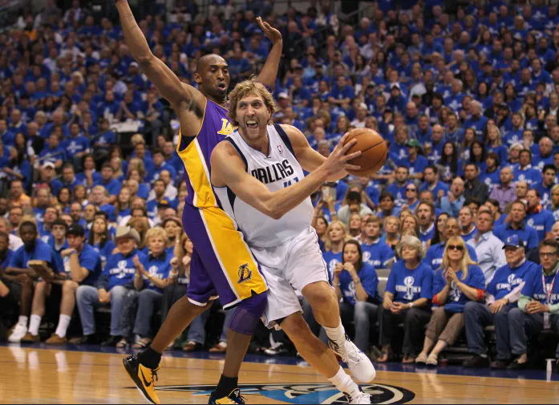
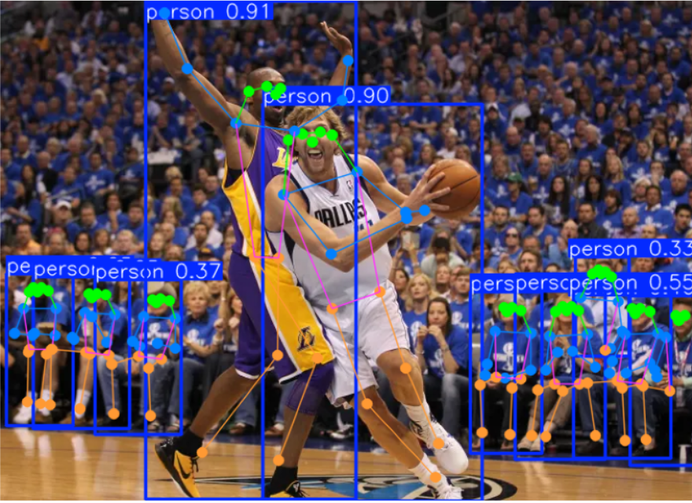
Why Deep Learning (DL) Model?
Object Detection
Keypoint Estimation
Recognizing object (person) from raw pixel image
Convolutional Neural Network is great at object detection and fast
Derive meaningful coordinates to understand body parts and spatial position
Intersection over Union (IOU)

Slide 6
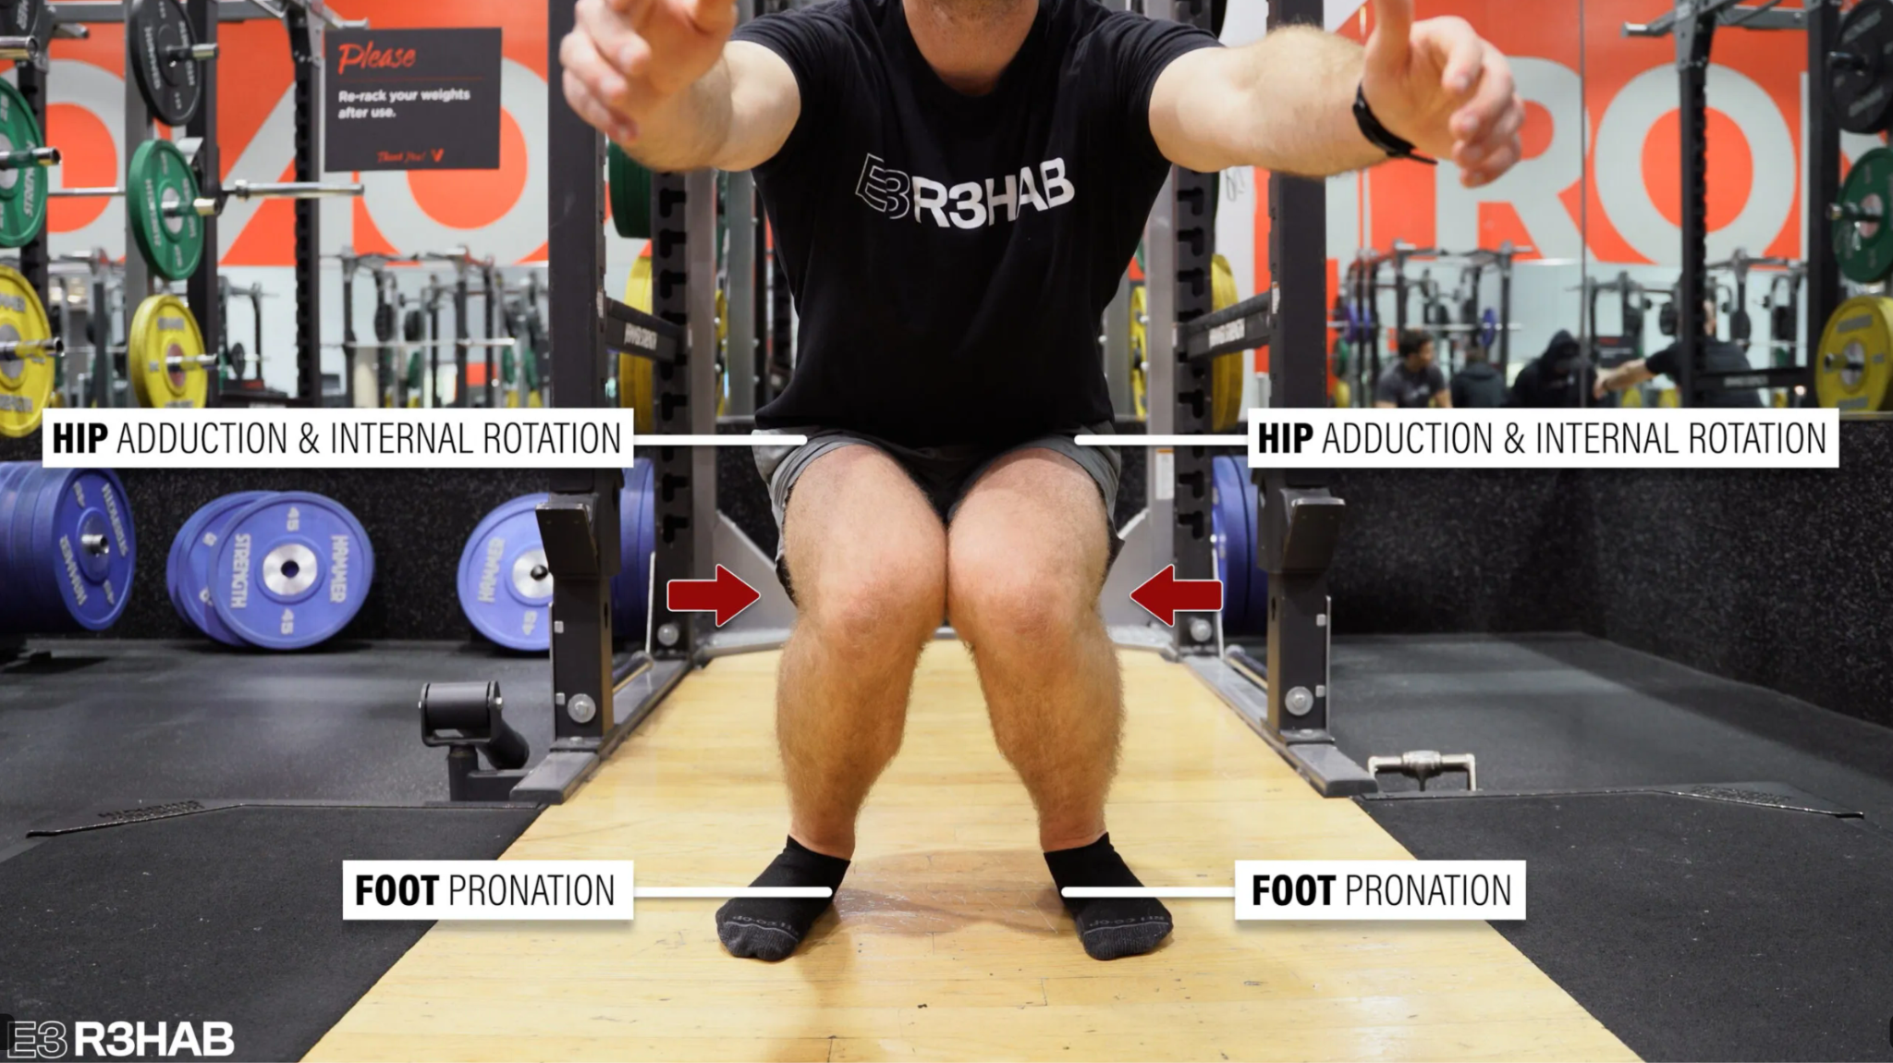
Why Machine Learning (ML) Model?
Learn from Labeled Data
Clearer reasoning model as opposed to “black box” relationship in DL
Can be more Domain-specific
Biomechanical experts can label faults they see
Applies rules/patterns to classify squat form
Easier interpretability for us humans
Similar decision making to humans
Perform better with smaller datasets
Make stronger assumptions

Slide 7
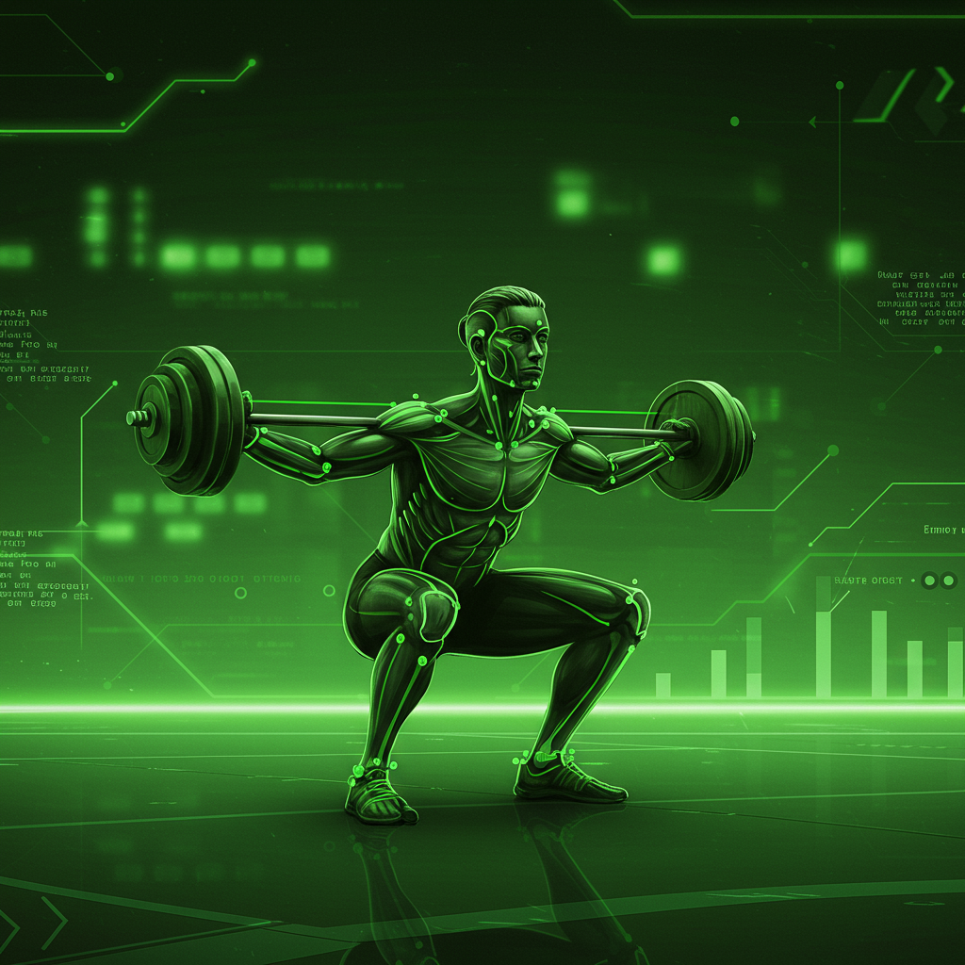
Hybrid Approach
Pure DL models alone are Computationally Expensive
Less Data Required
Decoupled development
Pose model
Feature Engineering
ML Classification
Complexity of CNN in object detection and pose estimation
Accessible/
Interpretability of classification of ML
Real-time application

Slide 8
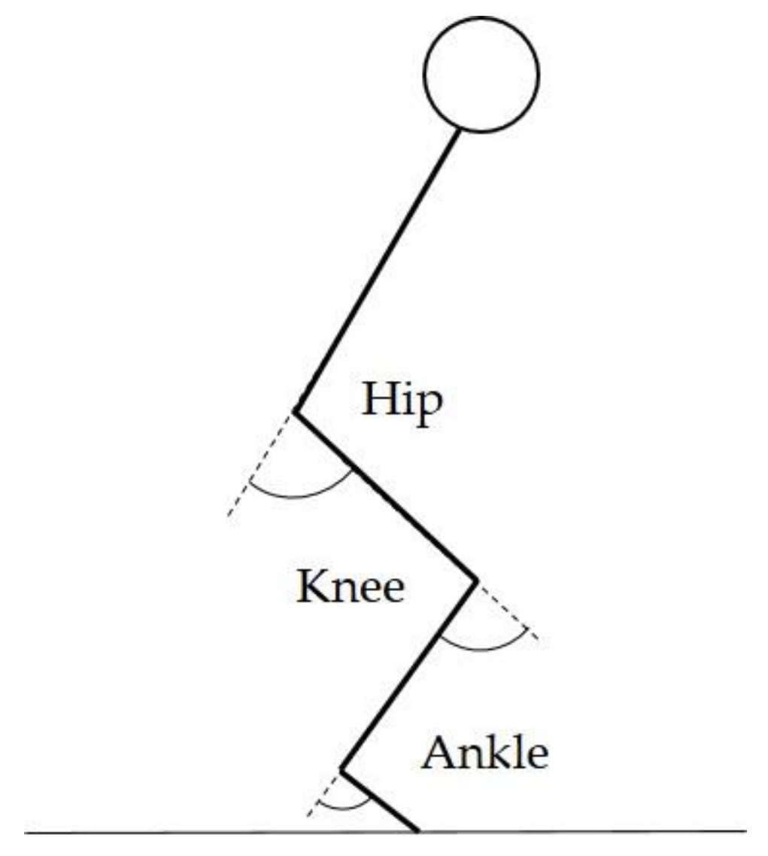
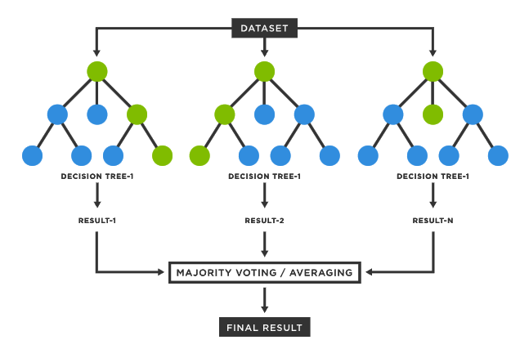
Plan of Action
Train using Convolutional Neural Network model
Engineer features based on key-point skeleton
Train Machine-Learning model for Classification
Transfer learning (Ultralytics) YOLOv11 for object detection
Retrain on 19 key-point Skeleton
Predict a Key-point skeleton on class-object
Create meaningful features relating key-points
Joint angles
Spatial displacement ratios
Logistic Regression
Support Vector
Naive-Bayes
K-Nearest Neighbors
Random Forest Classifier

Slide 9
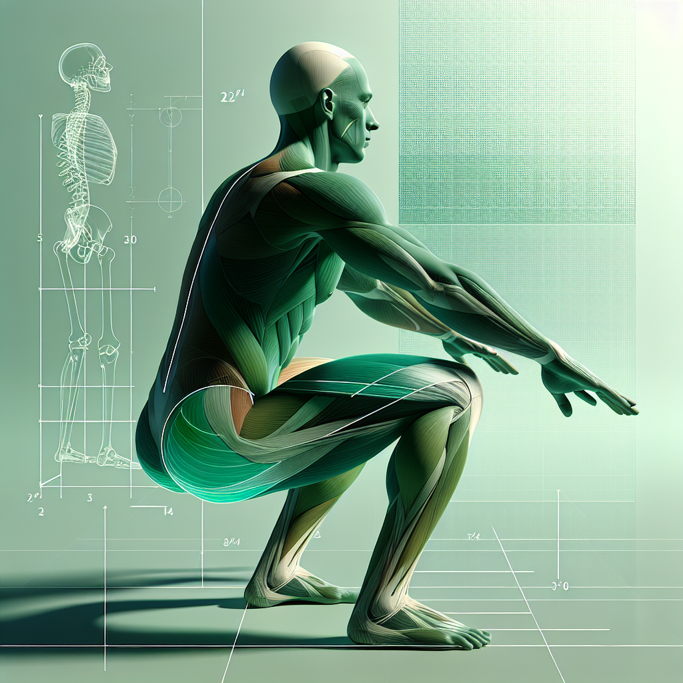
Tools
Libraries
Pytorch
Sklearn
Pandas
Numpy
Matplotlib
Pyplot
animation
Seaborn
CV2
Roboflow:
Data Annotation
IDE
VS Code
Cloud-Notebooks for Computing
Google Colab
Kaggle
LLMs
ChatGPT
Gemini
Claude

Slide 10

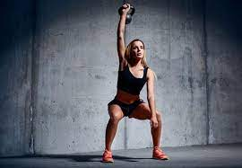


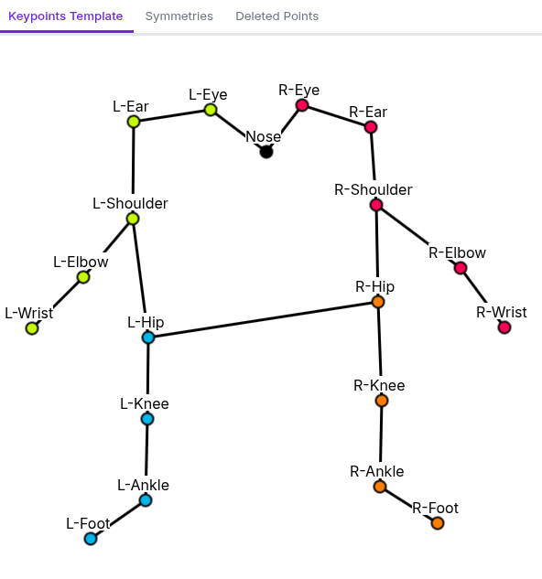
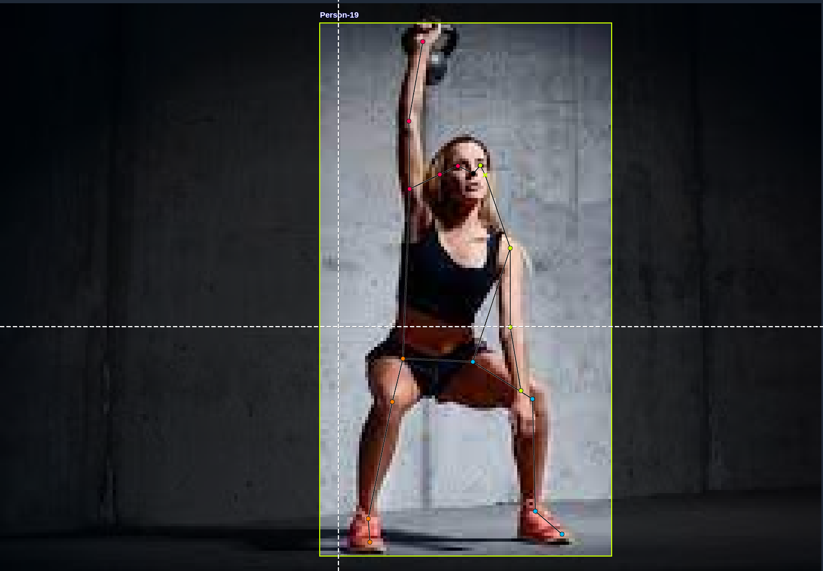
Dataset
Images:
(Currently 770 Images - 1901 after augmentation)
Taken from Roboflow public image datasets, youtube, instagram, and personal recordings
Mixture of same person squatting and variable people
Grayscale, Hue, and Blur Image Augmentation on 15%
Roboflow
“Feedback” Labels (currently 14 Tags)
Point-of-View: POV-Front, POV-Side, POV-Back)
Equipment: Barbell, Free/Body-Weight
Squat Range: No-Squat, Partial-Squat, Full-Squat, Deep-Squat
Movement “Faults”: Genu-Valgus, Heels-Up, Forward-Trunk, Ankle-Pronation, Toes-Out
1 class: Person
Custom 19-point skeleton
Visibility
Visible(o)
Occluded (x)
Deleted

Slide 11
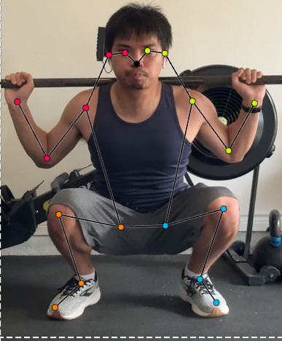
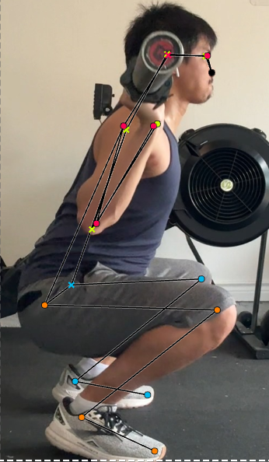
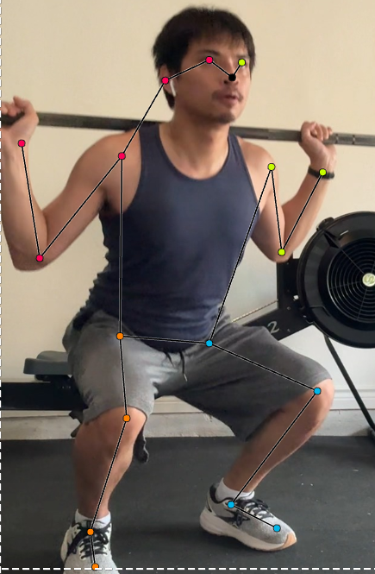
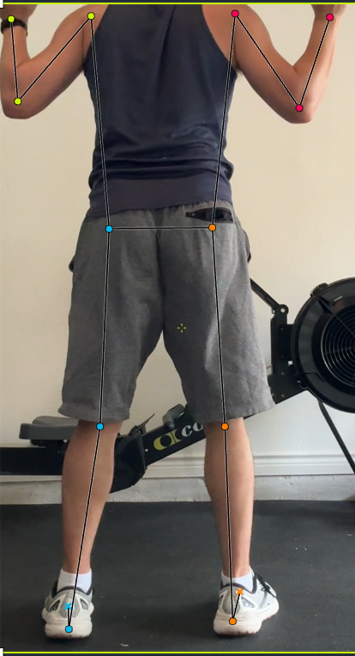
Classification Tag Examples
Barbell,
POV-Front, Deep-Squat, Toes-Out
Barbell,
POV-Side, Full-Squat, Heels-Up
Barbell,
POV-Side, Partial -Squat, Toes-Out
Barbell,
POV-Back, No-Squat

Slide 12
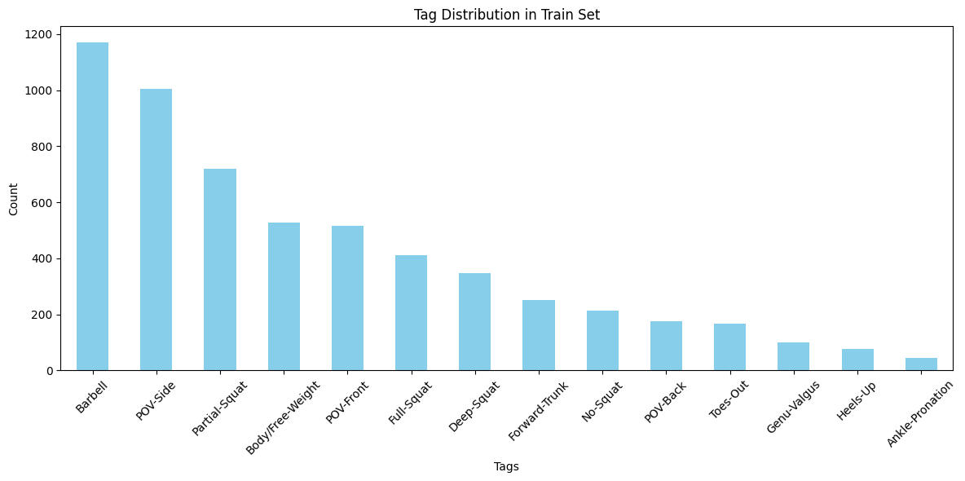
Distribution of Classifications
Version 19
Total Training Images:
1697
Training:
Barbell: 1169
POV-Side: 1004
Partial-Squat: 719
Body/Free-Weight: 528
POV-Front: 516
Full-Squat: 411
Deep-Squat: 348
Forward-Trunk: 252
No-Squat: 213
POV-Back: 177
Toes-Out: 168
Genu-Valgus: 99
Heels-Up: 77
Ankle-Pronation: 45

Slide 13
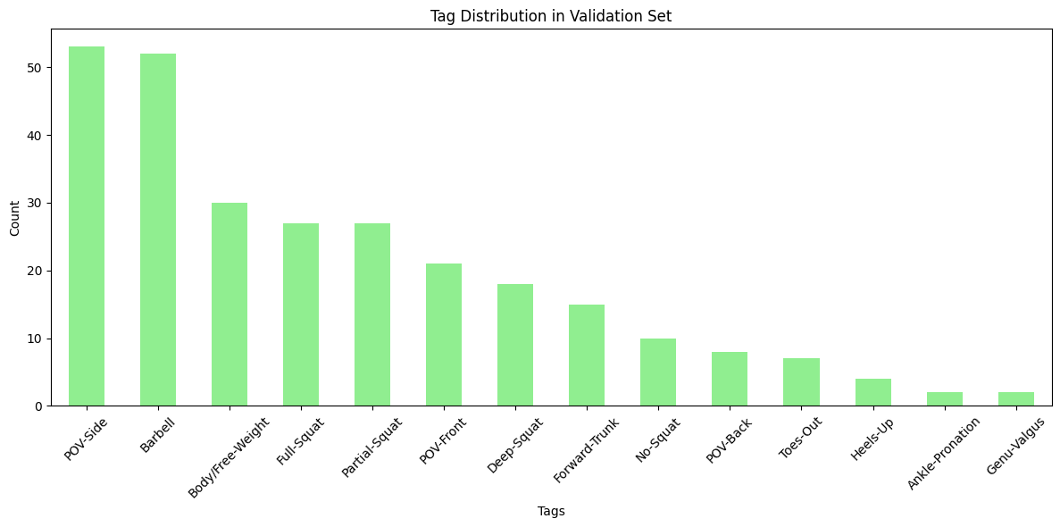
Distribution of Classifications
Validation:
POV-Side: 53
Barbell: 52
Body/Free-Weight: 30
Full-Squat: 27
Partial-Squat: 27
POV-Front: 21
Deep-Squat: 18
Forward-Trunk: 15
No-Squat: 10
POV-Back: 8
Toes-Out: 7
Heels-Up: 4
Ankle-Pronation: 2
Genu-Valgus: 2
Version 19
Total Validation Images:
82

Slide 14
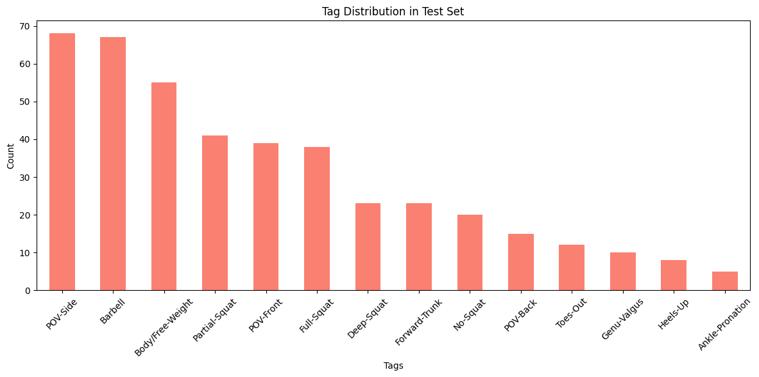
Distribution of Classifications
Version 19
Total Test Images:
122
Testing:
POV-Side: 68
Barbell: 67
Body/Free-Weight: 55
Partial-Squat: 41
POV-Front: 39
Full-Squat: 38
Deep-Squat: 23
Forward-Trunk: 23
No-Squat: 20
POV-Back: 15
Toes-Out: 12
Genu-Valgus: 10
Heels-Up: 8
Ankle-Pronation: 5

Slide 15
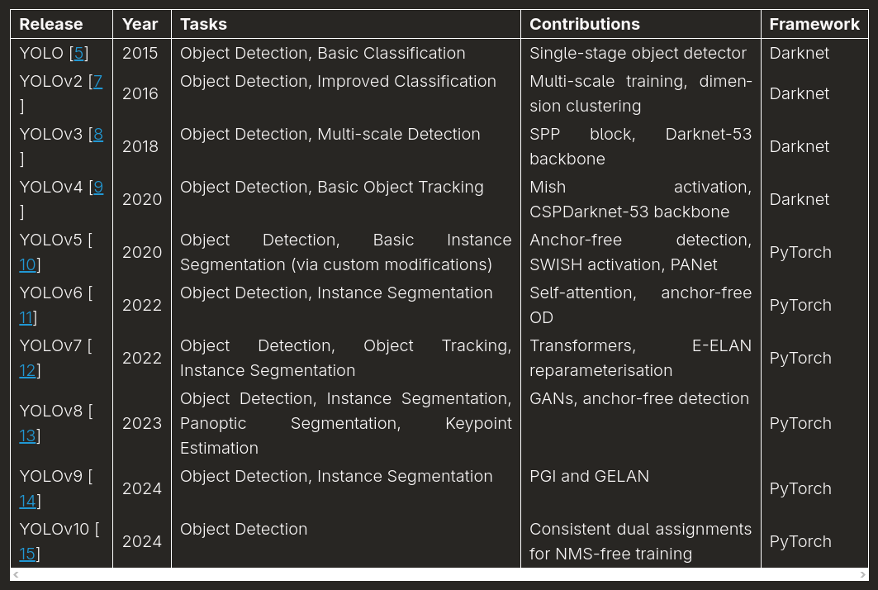
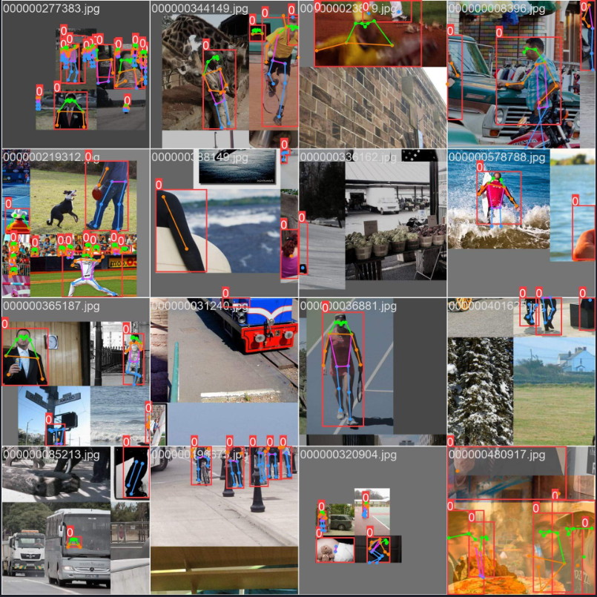
You-Only-Look-Once (YOLO)
Ultralytics YOLOv11 Pose Estimation Model with 17 Keypoints has already been trained on COCO dataset

Slide 16
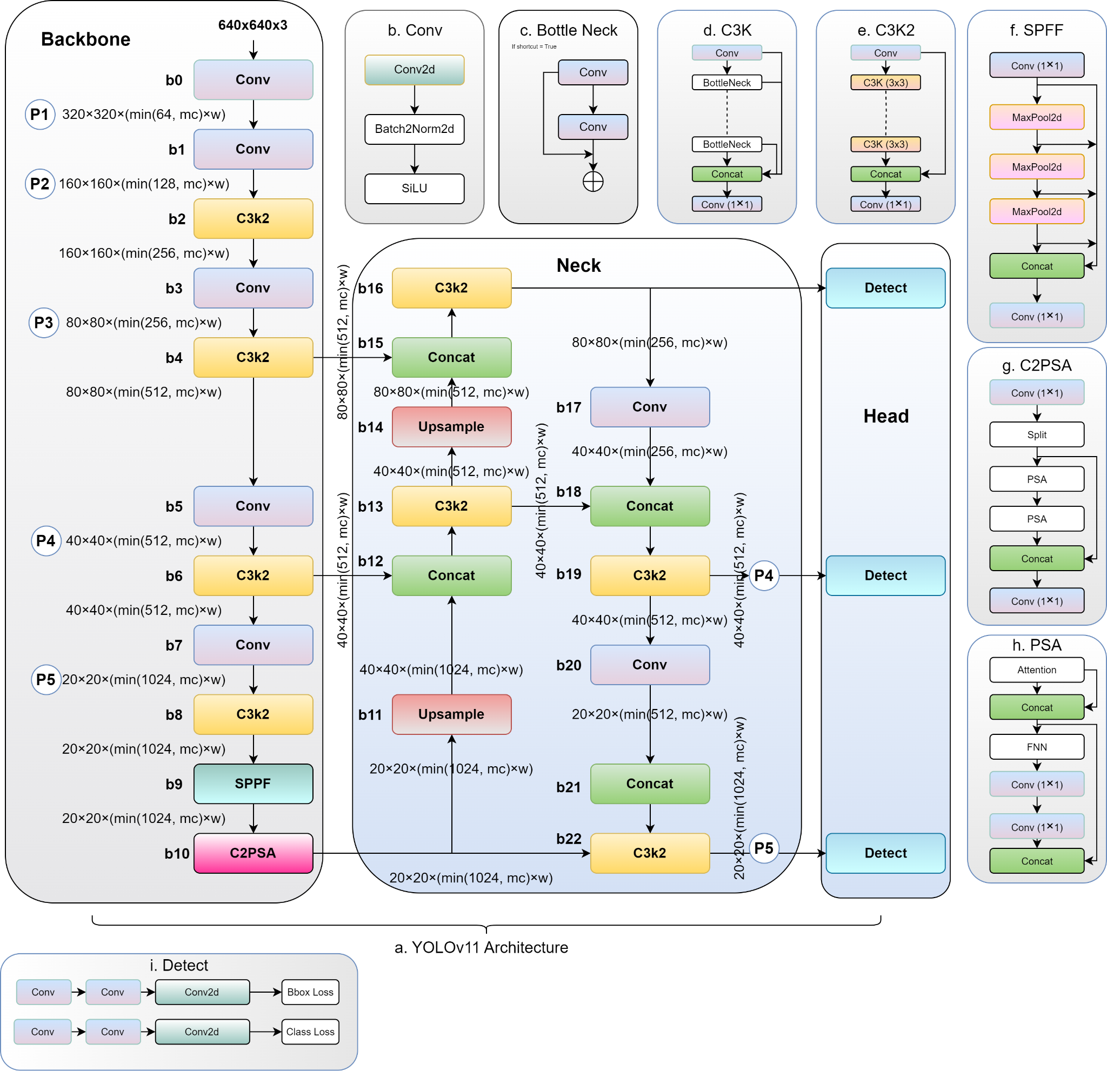
Training Pose Estimation
Train YOLOv11 Model on 19-keypoint Skeleton
Epochs: 100
Batch size: 16
image size: 640 pixels
Optimizer: SGD (Default)
Learning Rate: 0.01 (Default)
Learning Rate Schedule: cosine annealing (Default)
Link = https://arxiv.org/html/2410.17725v1

Slide 17
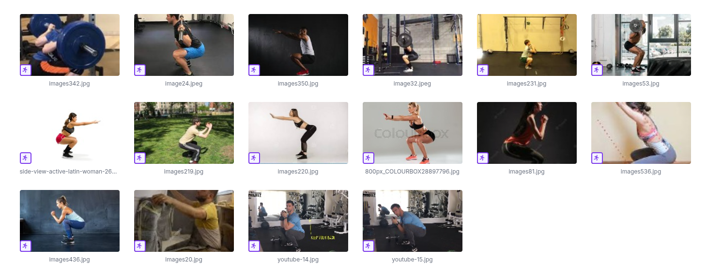
Image Examples

Slide 18
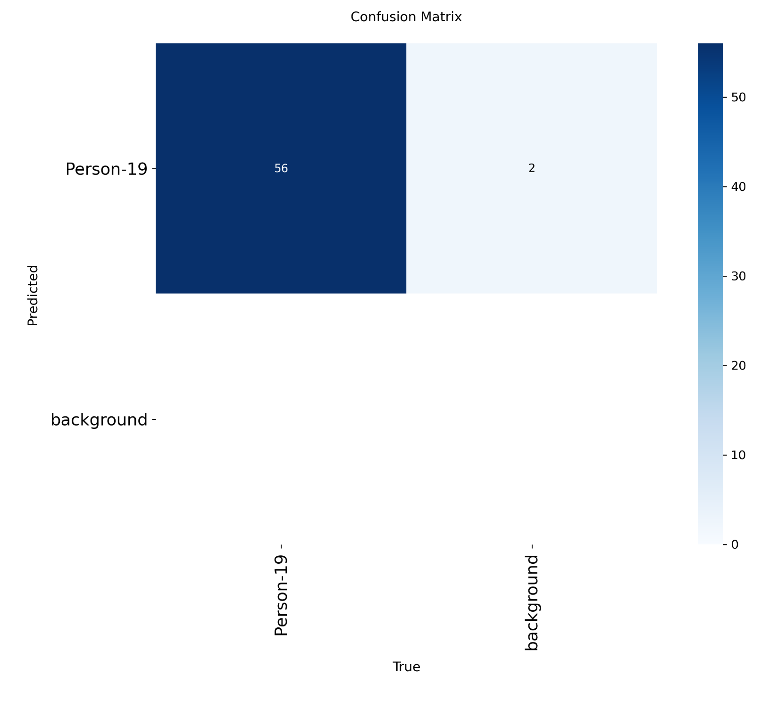
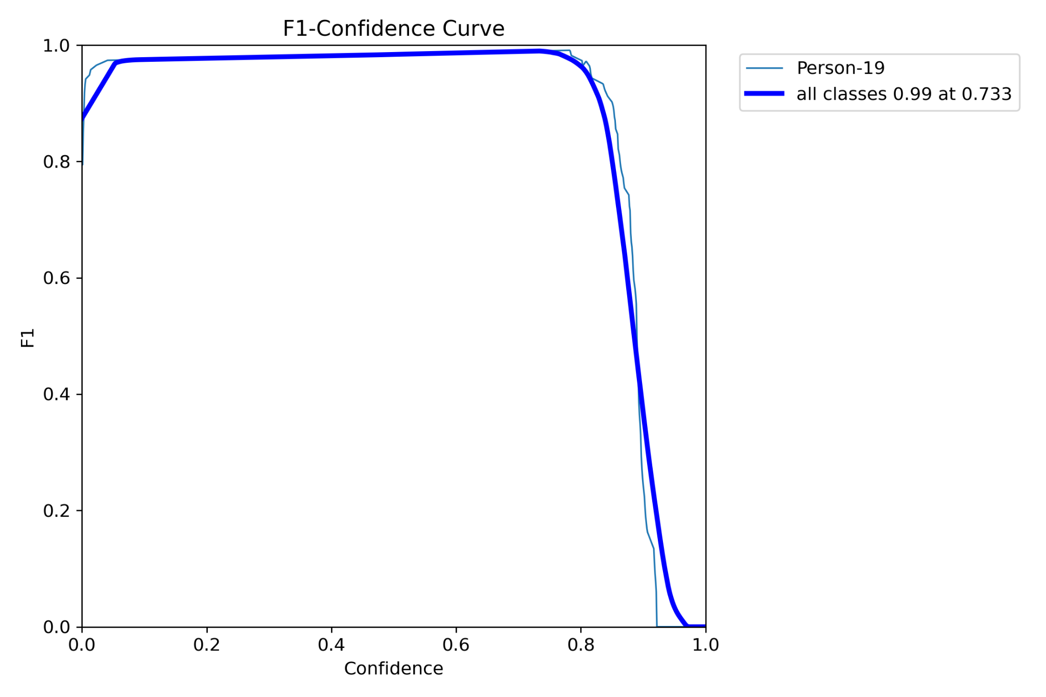
Object Detection Metrics

Slide 19
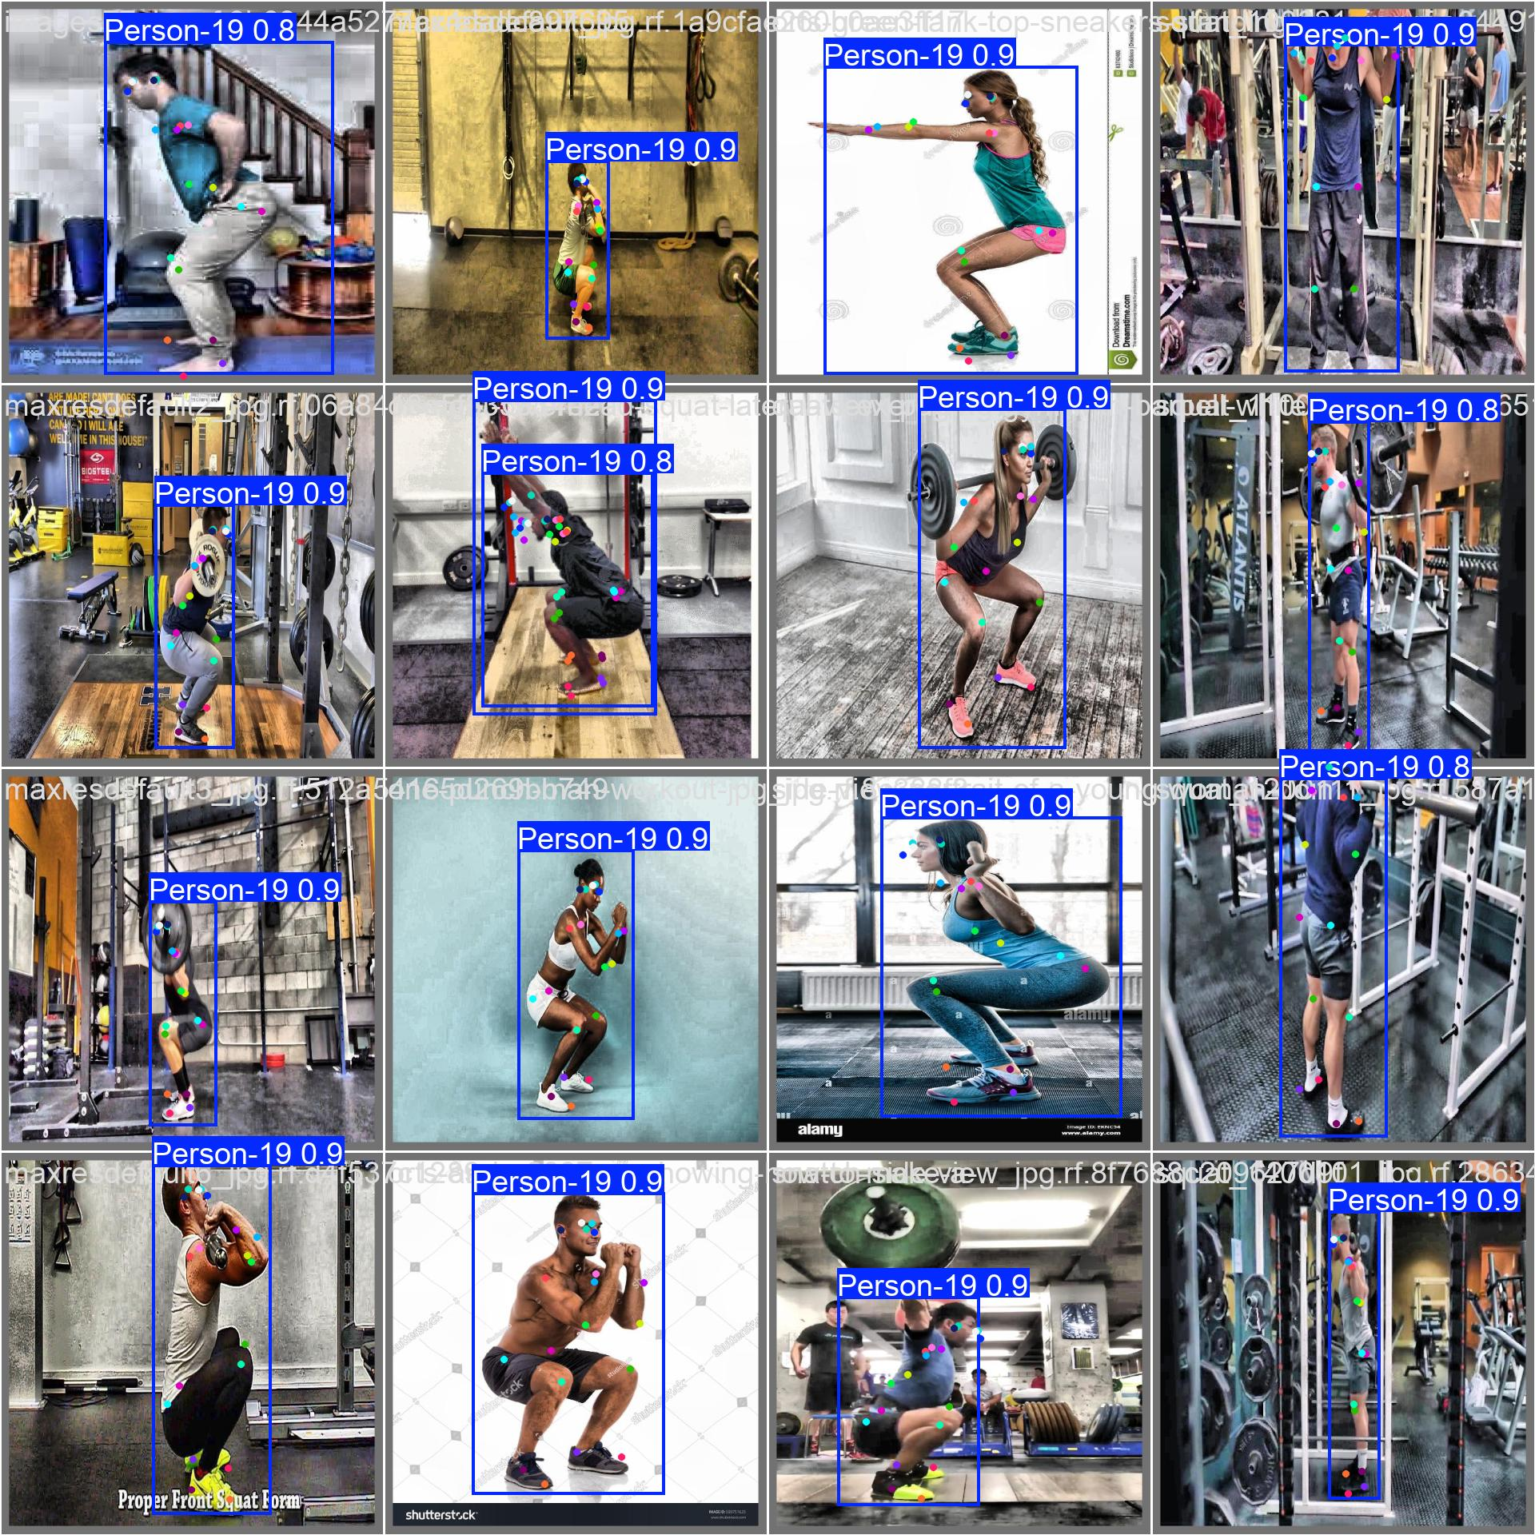
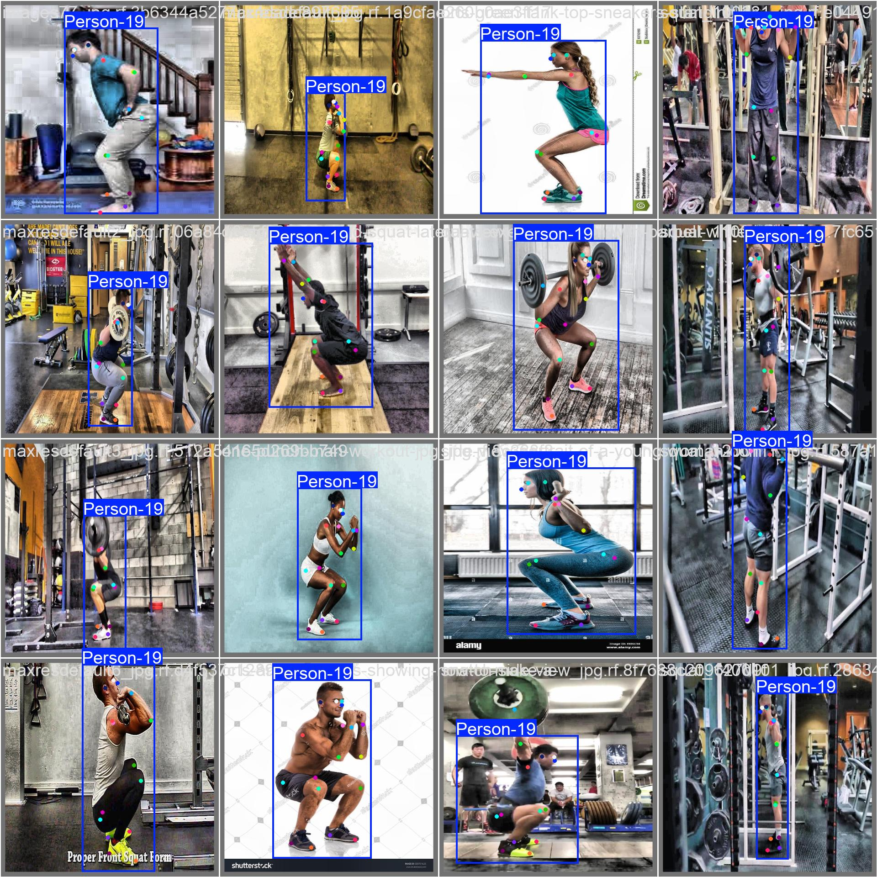
Object Detection Metrics

Slide 20
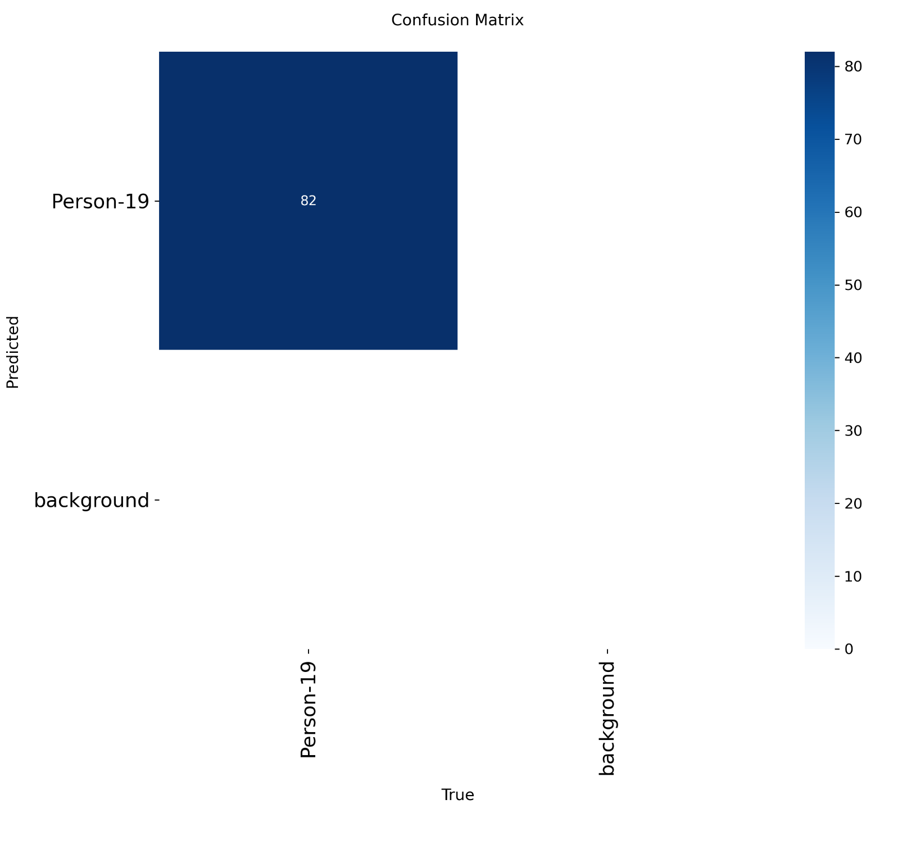
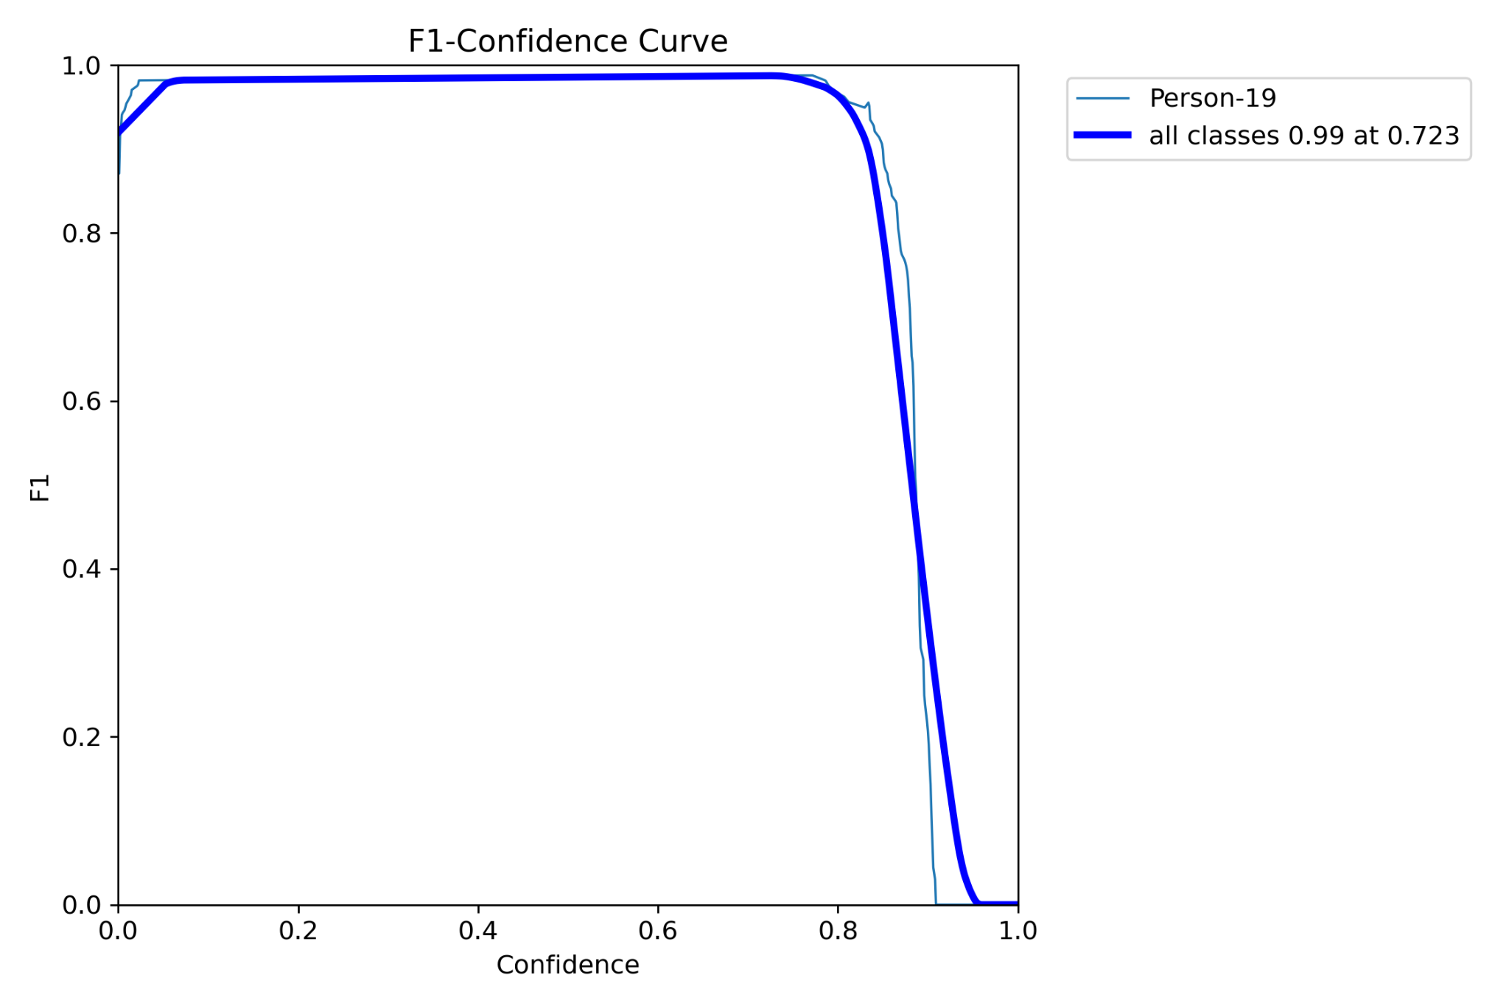
Object Detection Metrics (Updated)

Slide 21
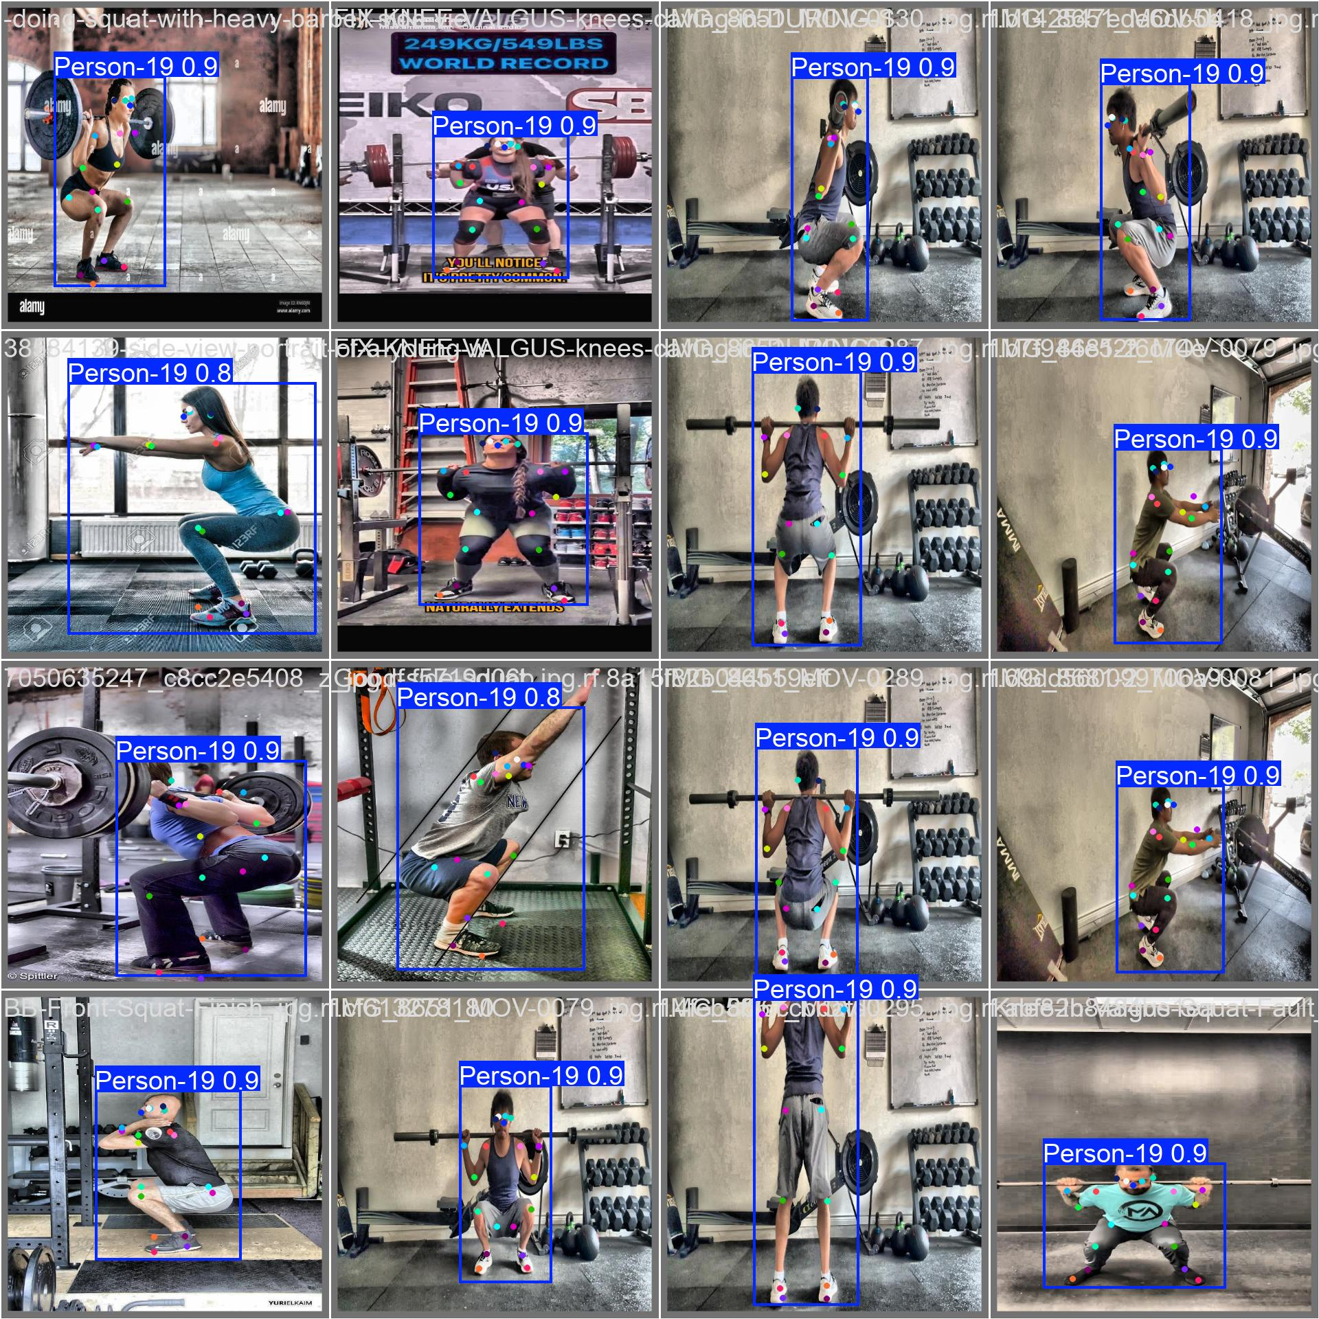
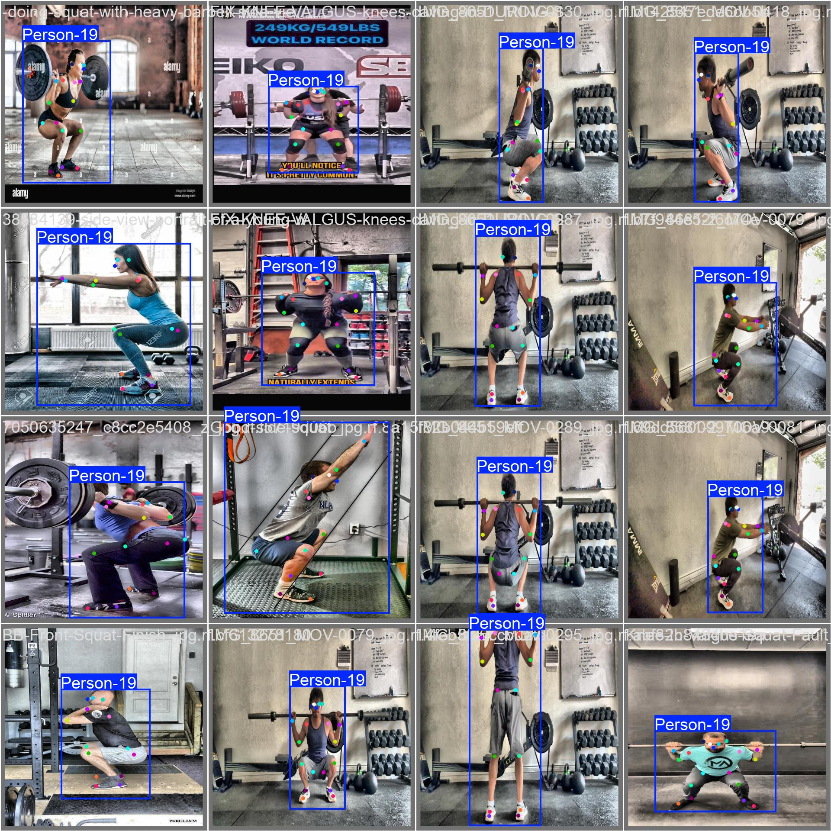
Object Detection Metrics

Slide 22
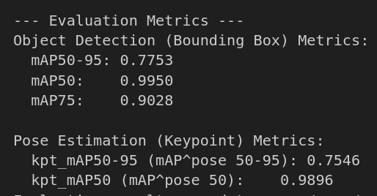
Pose Estimation Metrics
Accuracy Metrics
Object Detection Metrics
Mean Average Precision (mAP)
(0.0-1.0) - higher is better
mAP50-95 (Overall)
mAP50 (Lenient accuracy)
mAP75 (Strict accuracy)
How much of predicted bounding box over overlaps with Ground Truth
Pose Estimation Metrics - how accurate model predicts keypoints
Object Keypoint Similarity (OKS) - "like IoU for keypoints"
kpt_mAP50-95
kpt_mAP50

Slide 23
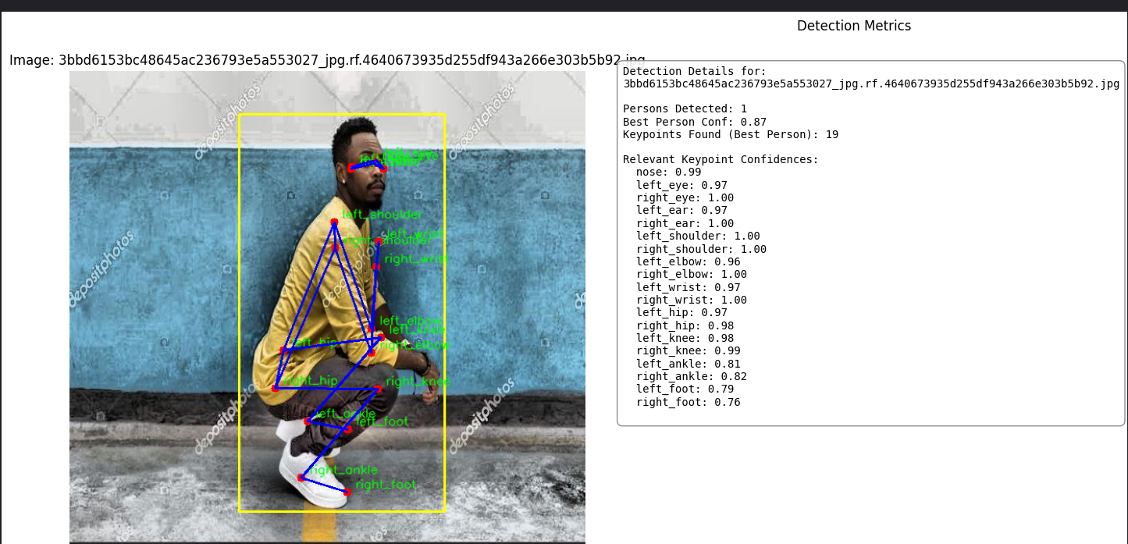
Pose Estimation Metrics
Keypoint Confidence: “Model’s Certainty”

Slide 24
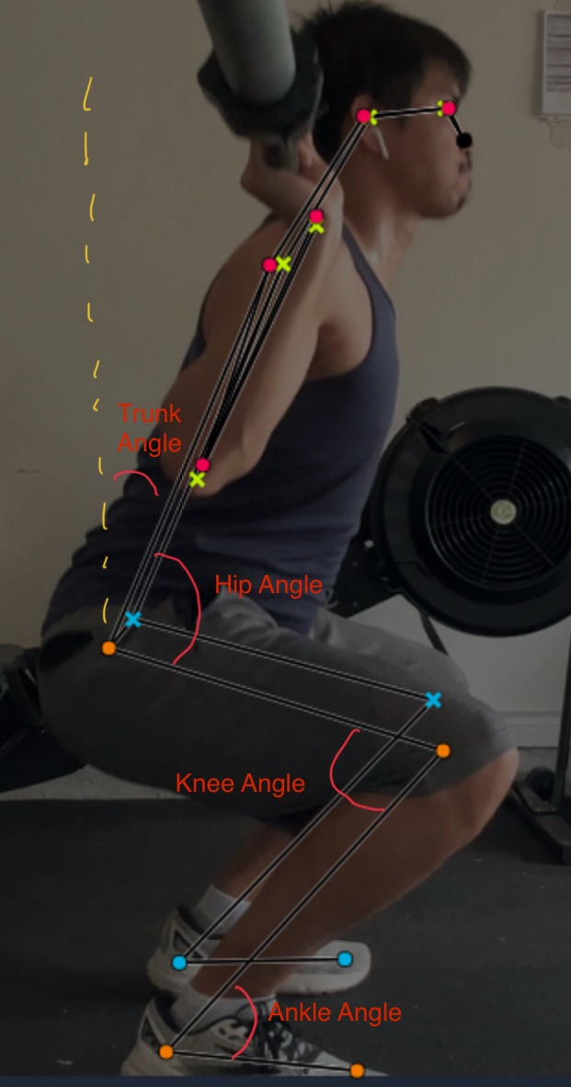
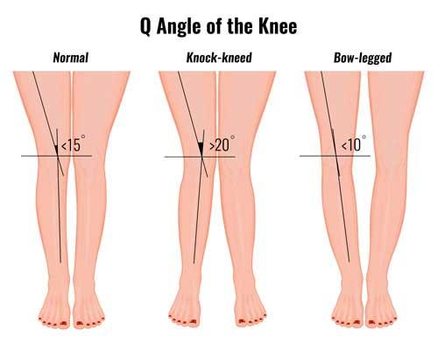
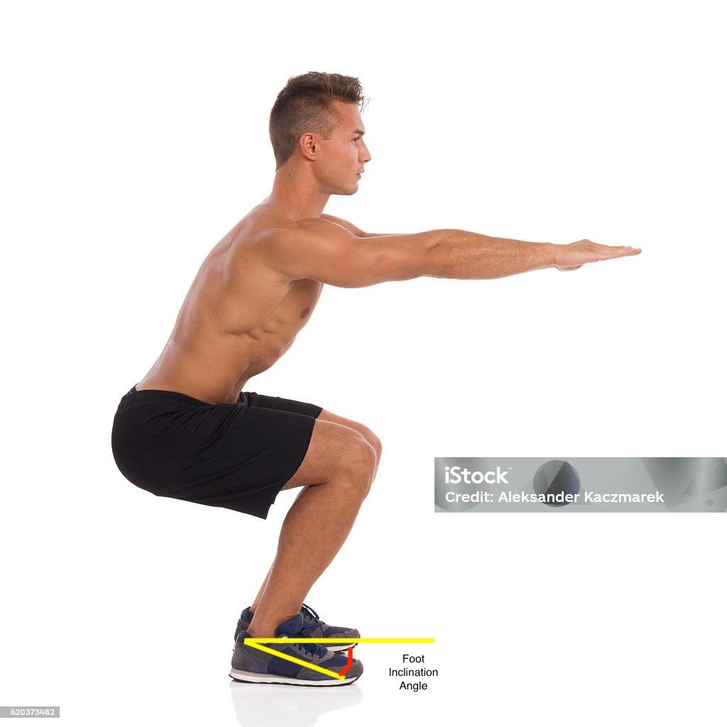
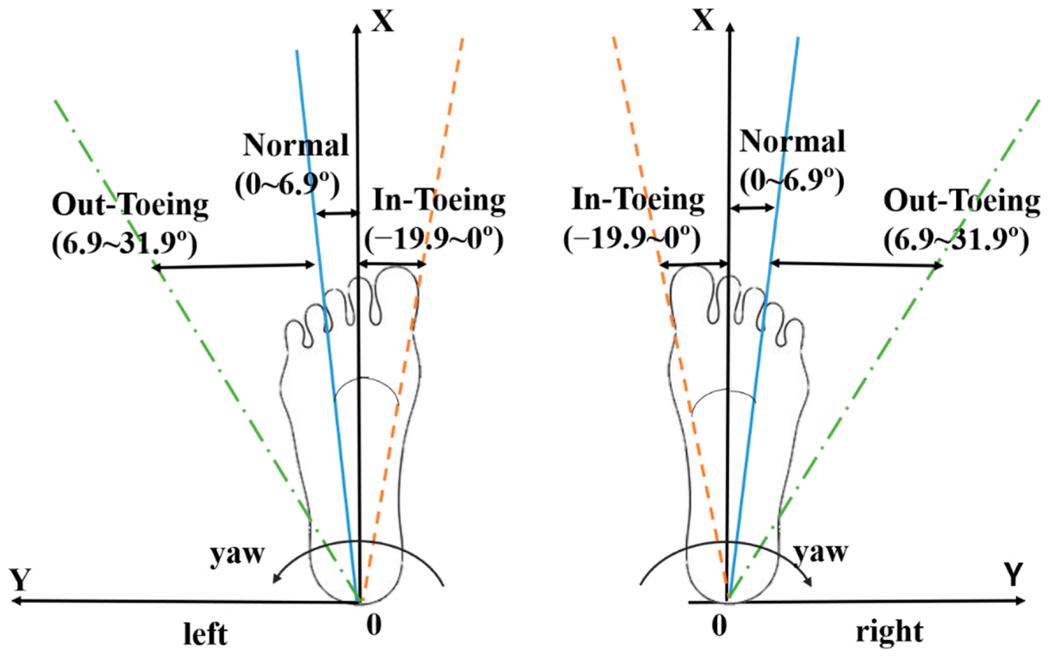
Feature Engineering
Joint Angles: (13 features)
Hip Angle (Shoulder-Hip-Knee) - R/L
Knee Angle (Hip-Knee-Ankle) - R/L
Ankle Angle (Knee-Ankle-Foot) - R/L
Trunk Angle
Representing absolute degrees of trunk to true vertical
Femoral Coronal Angle (Q-Angle) - R/L
Foot-Inclination angle - R/L
Representing angle between horizontal line from ankle and ankle-foot line
Foot-Orientation angle - R/L
Representing toe out/in reference to vertical reference point

Slide 25
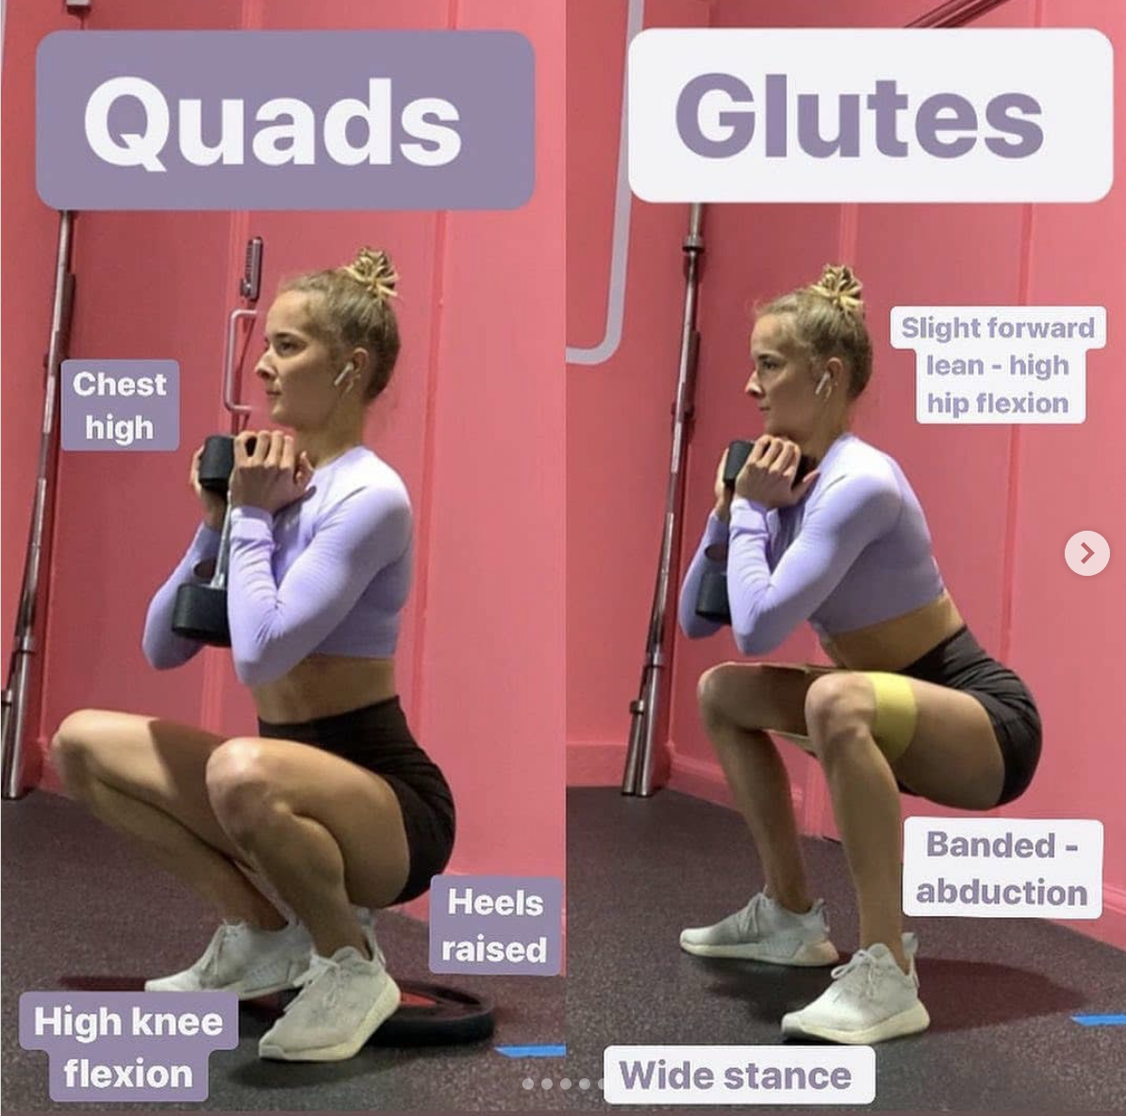
Feature Engineering
Distances/Ratios: (6 features)
Torso-Horizontal-Lean ratio
Horizontal displacement of shoulders relative to hips
Hip-Knee-Horizontal-offset ratio
Horizontal displacement of hip relative to knees
Knee-Ankle Horizontal-offset
Horizontal displacement of knee relative to ankles
Hip-Ankle-Horizontal-offset ratio
Horizontal displacement of hips relative to ankles
Foot-Stability-Horizontal spread ratio
How wide of stance feet normalized to hips
Ankle-Foot vertical distance
Vertical distance between ankle and foot

Slide 26
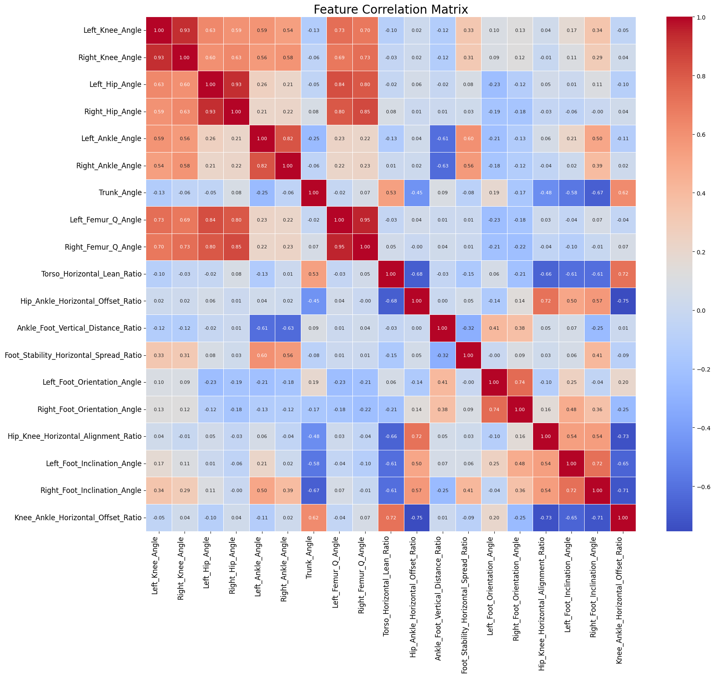
Correlation Matrix
Strong positive correlations
between symmetrical sides
between hip and knee angles (deeper the squat the "smaller the angles")
Moderately strong negative correlations
between trunk and hip angles
Moderately strong positive correlation
between Trunk angle and torso horizontal displacement
between hip-knee alignment and trunk angle
Low correlation
between Q angle and foot spread ratio
between ankle angle and trunk angle

Slide 27
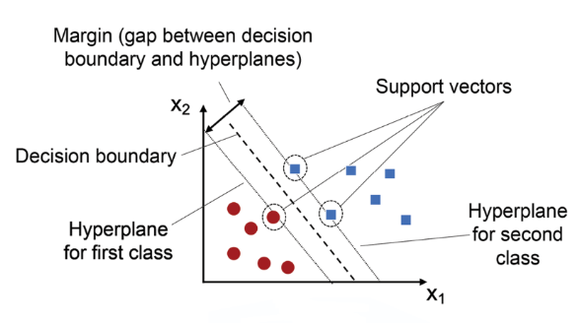
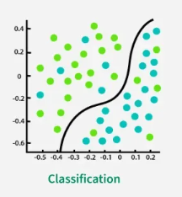
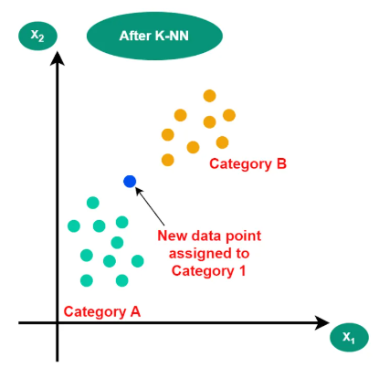
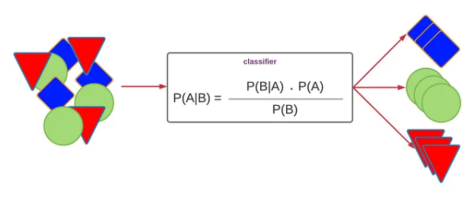
Machine Learning Classifiers
Logistic
Support Vector (SVC)
Naive-Bayes
K-Nearest Neighbor
Random Forest
Linear Decision Boundary via a weight sum of the features passed through a sigmoid function
Finds optimal hyperplane that separates each class and maximize margin between support vectors
Calculate probability of each class given input features by assuming that all features are conditionally independent
Classify new data point by finding closest k closest training examples and assigns most common class among k neighbors
Ensemble of decision trees
Series of if-then-else rules
Balanced RFC can help handle class imbalance

Slide 28
Machine Learning Classifiers
Logistic
SVC
NB
KNN
Balanced RFC
F1 Score
Micro Avg: 0.64
Macro Avg: 0.49
Weight Avg: 0.58
Samples avg: 0.62
F1 Score
Micro Avg: 0.78
Macro Avg: 0.57
Weight Avg: 0.73
Samples avg: 0.75
F1 Score
Micro Avg: 0.67
Macro Avg: 0.61
Weight Avg: 0.71
Samples avg: 0.67
F1 Score
Micro Avg: 0.75
Macro Avg: 0.68
Weight Avg: 0.74
Samples avg: 0.74
F1 Score
Micro Avg: 0.82
Macro Avg: 0.73
Weight Avg: 0.81
Samples avg: 0.82
Need this to be high to catch the “rare cases”
Micro - “How well did we do overall, counting each individual equally”
Macro - “How well did we do per class, and then take the average, regardless of class size”
Weighted - “Average F1 but give more weight to more frequent classes”
Samples- “How well did we do per data point, averaged across all points”

Slide 29
Machine Learning Classifiers
Logistic
SVC
NB
KNN
Balanced RFC
F1 Score
Micro Avg: 0.64
Macro Avg: 0.49
Weight Avg: 0.58
Samples avg: 0.62
F1 Score
Micro Avg: 0.78
Macro Avg: 0.57
Weight Avg: 0.73
Samples avg: 0.75
F1 Score
Micro Avg: 0.67
Macro Avg: 0.61
Weight Avg: 0.71
Samples avg: 0.67
F1 Score
Micro Avg: 0.75
Macro Avg: 0.68
Weight Avg: 0.74
Samples avg: 0.74
F1 Score
Micro Avg: 0.82
Macro Avg: 0.73
Weight Avg: 0.81
Samples avg: 0.82
Need this to be high to catch the more “common cases”
Micro - “How well did we do overall, counting each individual equally”
Macro - “How well did we do per class, and then take the average, regardless of class size”
Weighted - “Average F1 but give more weight to more frequent classes”
Samples- “How well did we do per data point, averaged across all points”

Slide 30
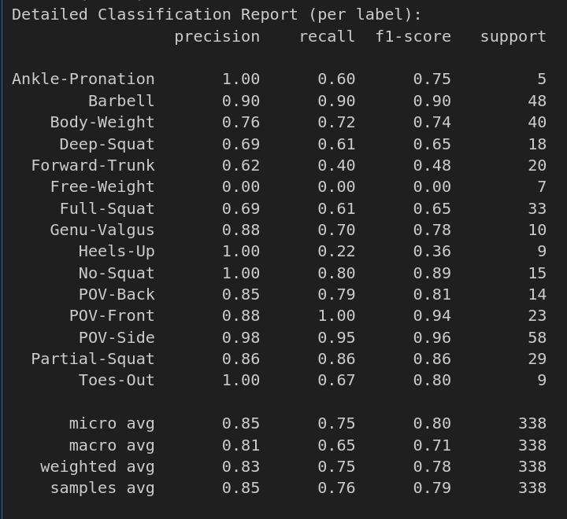
Balanced Random Forest Classifier
Precision
“Of all the predicted positives, how many were actually correct?”
Recall
“Of all the actual positives, how many did I catch?”
F1 Score
“Balance between precision and Recall”
Previous Version:
Separate
Body Weight
and
Free Weight
tags

Slide 31
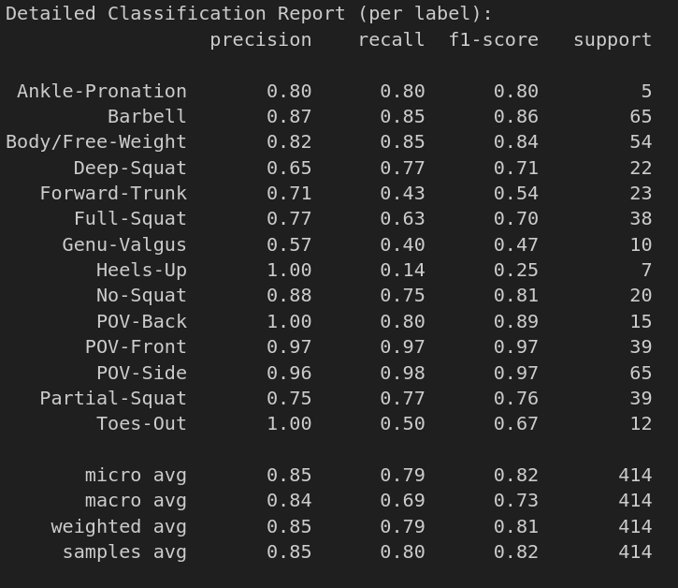
Balanced Random Forest Classifier
Precision
“Of all the predicted positives, how many were actually correct?”
Recall
“Of all the actual positives, how many did I catch?”
F1 Score
“Balance between precision and Recall”
Version 19:
Combined
Body/Free-Weight Tag

Slide 32
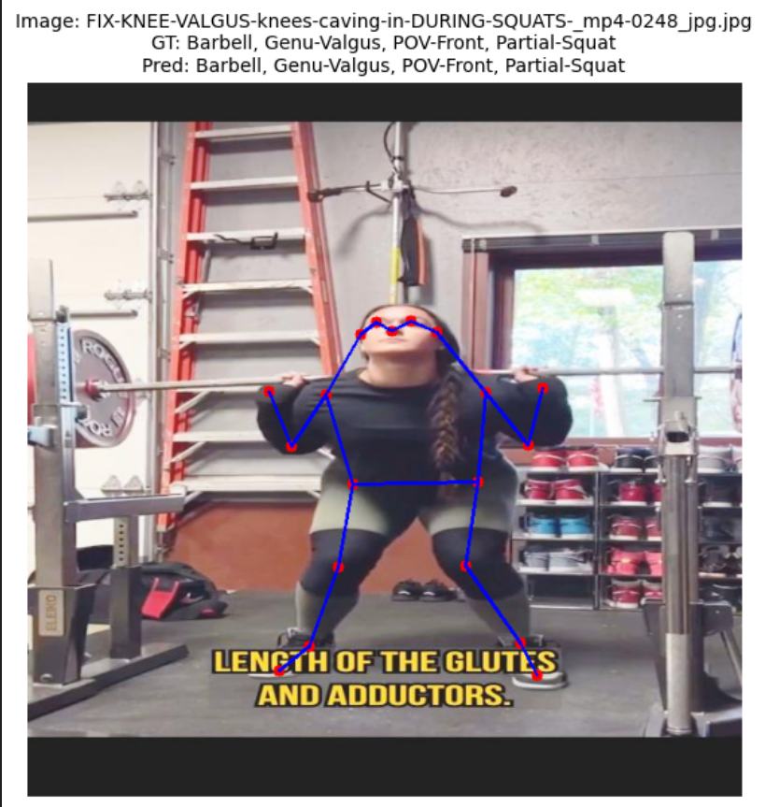
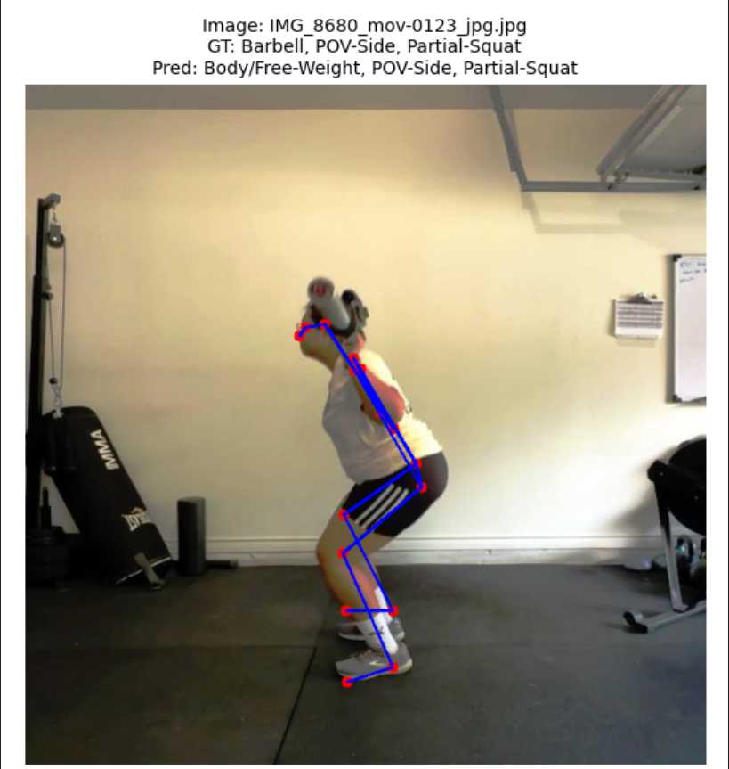
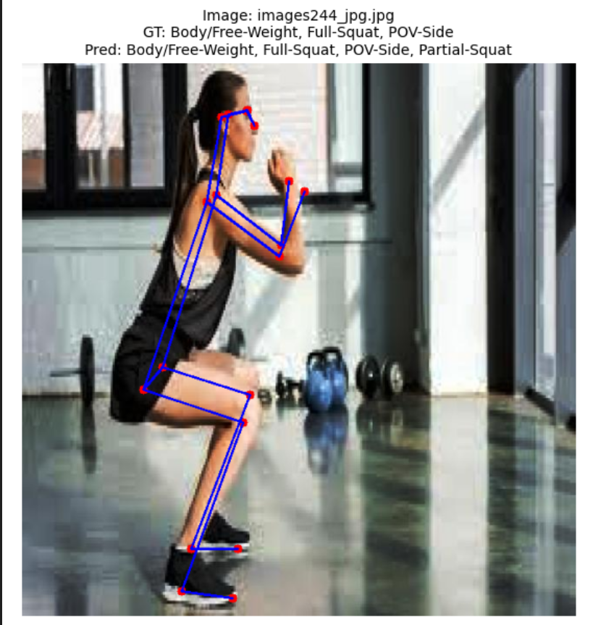
Classified Images

Slide 33
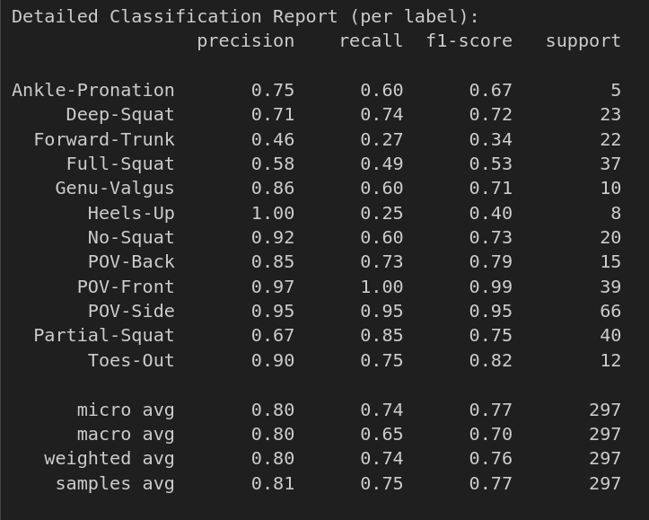
Balanced Random Forest Classifier
Precision
“Of all the predicted positives, how many were actually correct?”
Recall
“Of all the actual positives, how many did I catch?”
F1 Score
“Balance between precision and Recall”
Version 20:
Removed Equipment tags
Lower overall F1 score due to removal of high performing groups like barbell
Forward-Trunk may have been relying on “barbell” tag
Improvement in other “fault” classifications such as Genu Valgus, heels-Up, and Toes-Out

Slide 34

Video Squat Analyzer
Original

Slide 35

Video Squat Analyzer
With Squat Analyzer

Slide 36

Video Squat Analyzer
Original

Slide 37

Video Squat Analyzer
With Squat Analyzer

Slide 38

Video Squat Analyzer

Slide 39

Difficulties
Angle-sensitive labeling
Defining landmarks based on angle
Several Hidden/Occluded body parts in the training data
Human Error - inter/intrarater reliability
Image Quality
Sparsity of data
Especially with multiclass
NEED MORE IMAGE DATA
2D vs 3D
Poor results on ankle results
POV-Side contains ¾ turn images
Relying on learning through correlation

Slide 40


Future Improvements
Add Object Detection for Equipment
Currently combined Free-Weight with Body-Weight
Better standardization of quality of images
More variety of demographics
Age, race, clothing, etc
Add more tags of movement dysfunctions
Temporal Analysis of data
Sequencing of when dysfunctions happen
Further stratification of POV-classifications
Add ¾ turns
Object detection of the ground?
Possible help model relate person to the surface of the floor he/she is standing on

Slide 41



ChatGPT
Prompt: Analyze this photo?

Slide 42


ChatGPT
Prompt: Analyze this photo?

Slide 43
Conclusions
Model was able to accurately detect keypoint skeleton reliably but very sensitive to angles of the image/video
In concept, model was able to identify squat movement dysfunctions but much more labeled data is needed to capture more of the nuances and variations
YOLO’s real-time object detection shows promise for fitness and rehabilitation application

Slide 44

Any Questions?

